Slide 1




PEOPLE’S COMMITTEE OF TAN BINH DISTRICT
CHI LANG PRIMARY SCHOOL
Grade: 2
UNIT 6: AROUND TOWN
Teacher: Hoàng Thị Thanh Thảo

Slide 2
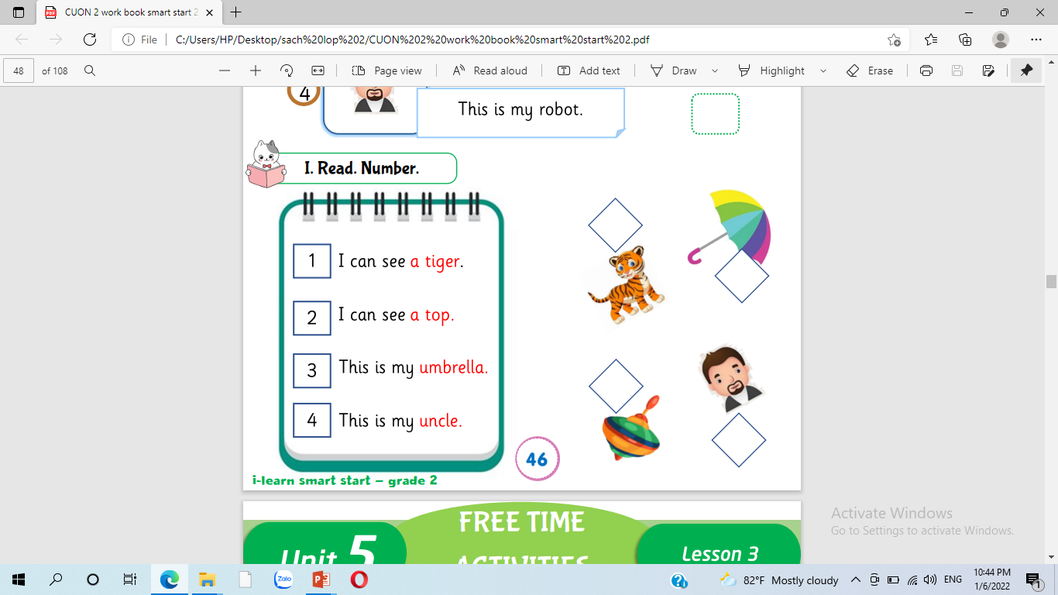
1
3
2
4

Slide 3
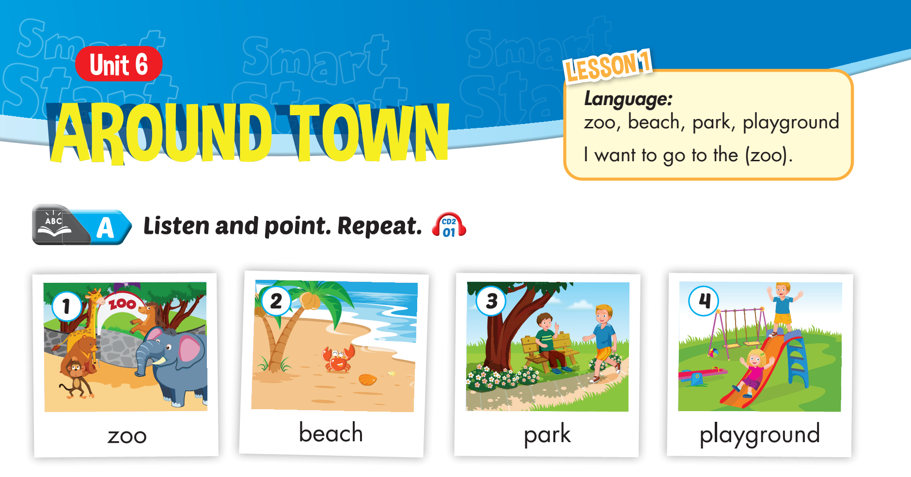


Slide 4
Lesson 1

Slide 5
Lesson 1

Slide 6
Lesson 1

Slide 7
Lesson 1

Slide 8
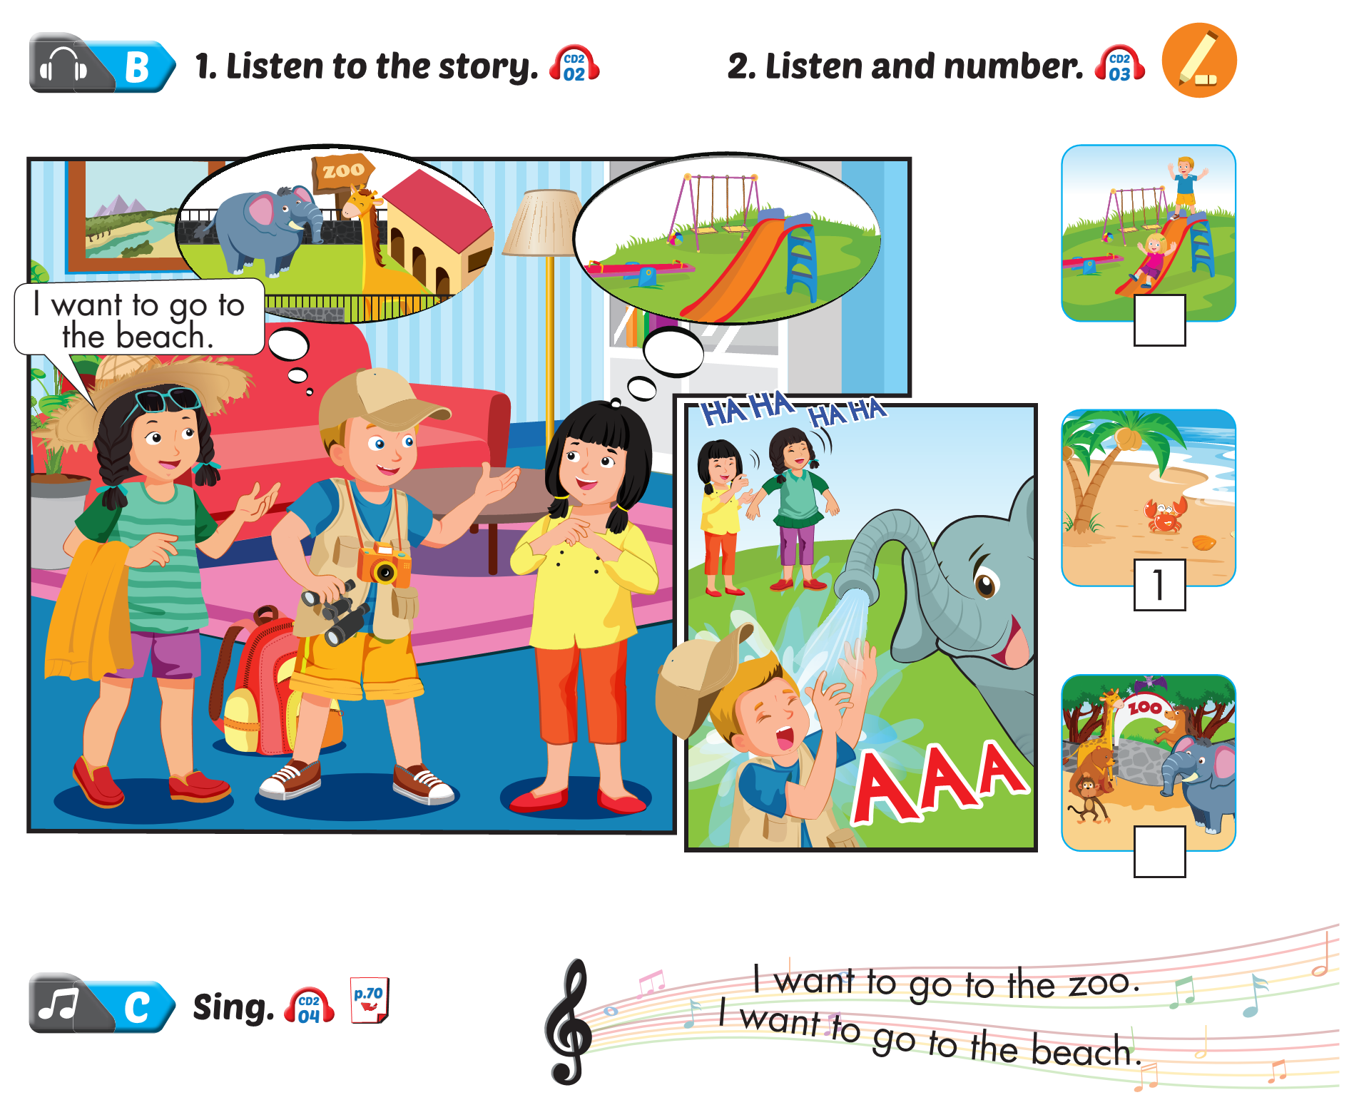
Lesson 1

Slide 9
Lesson 1
I want to go to
the zoo.

Slide 10
Lesson 1
I want to go to the zoo.

Slide 11
Lesson 1
I want to go to the beach.

Slide 12
Lesson 1
I want to go to the park.

Slide 13
Lesson 1
I want to go to the playground.

Slide 14
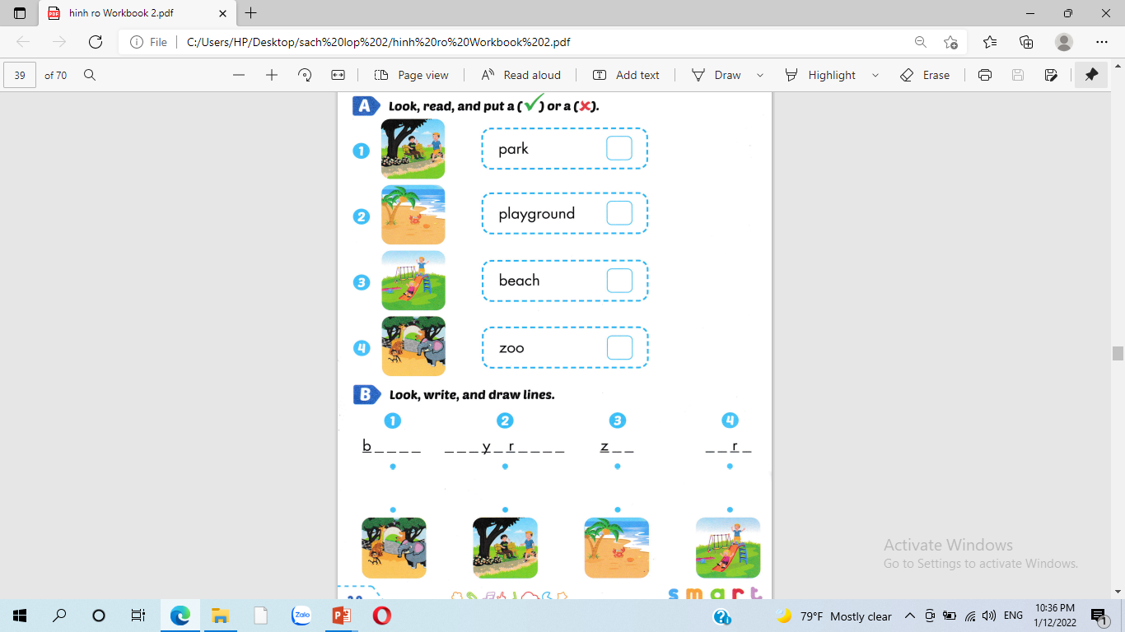


Lesson 1

Slide 15
Lesson 1
each
pla g ound
oo
pa k

Slide 16
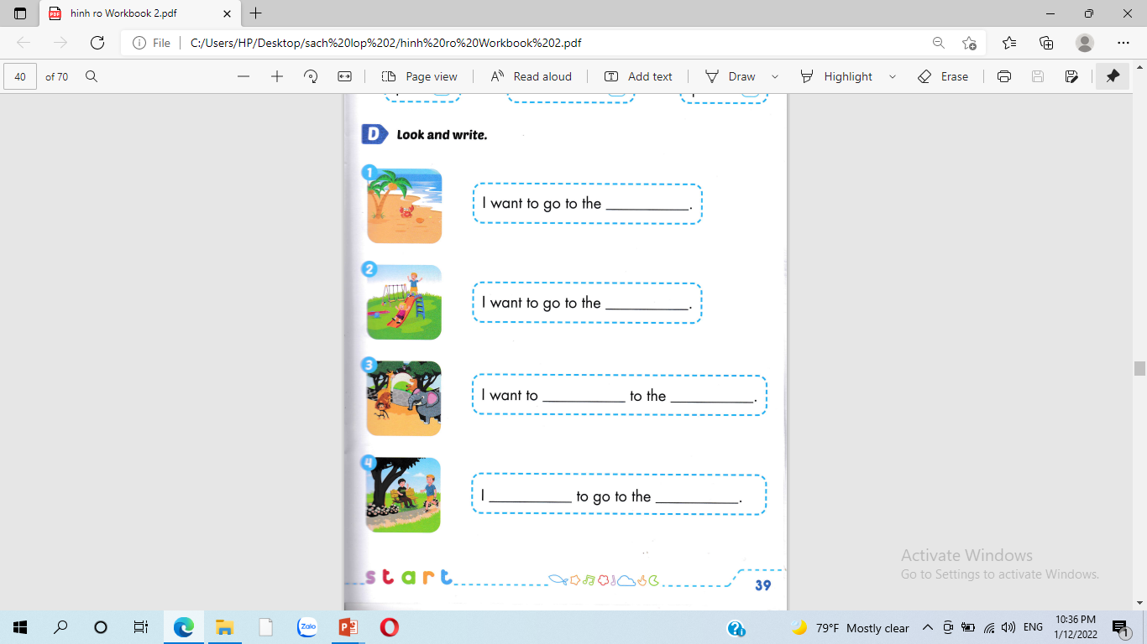
Lesson 1
beach
playground
go
zoo
want
park

Slide 17
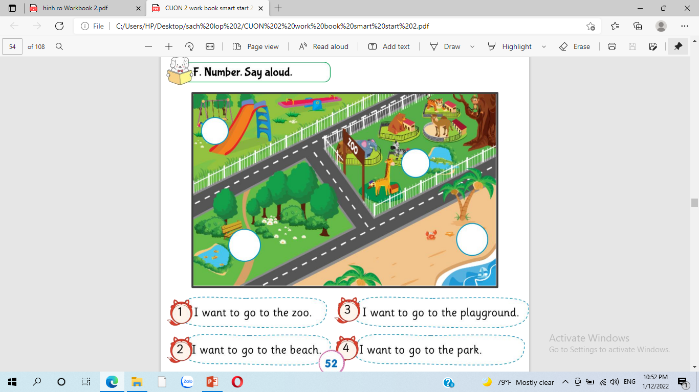
3
1
2
4

Slide 18
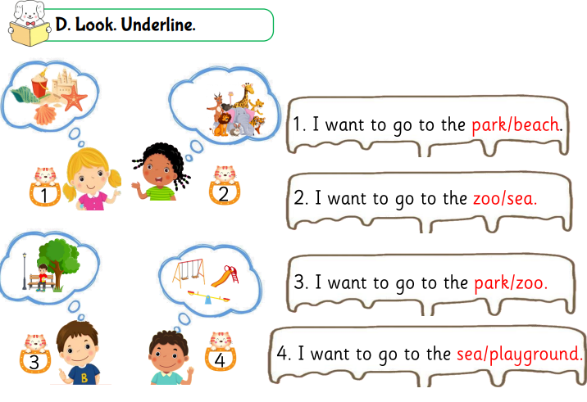

Slide 19
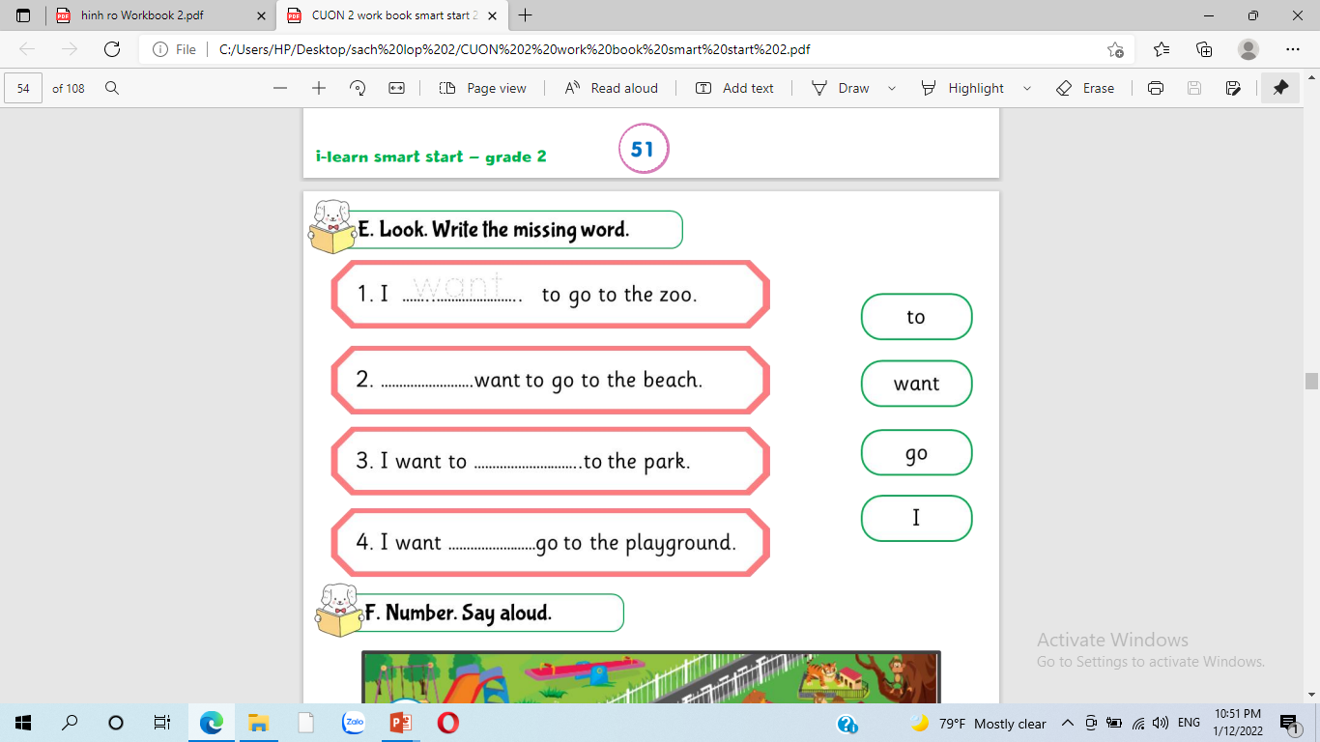
want
I
go
to

Slide 20






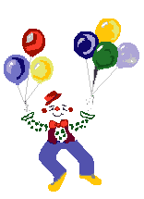
Thank you for enjoying
the lesson !

